Slide 1

COSC 1336 Fundamentals of Programming
Computing
Understand basics of computing
Understand computation

Slide 2
Computing Introduction
💻 What is a Computer?
A computer is an electronic device that performs arithmetic and logical calculations.
It processes, stores, and outputs data based on a set of instructions called programs.
Computers are used to carry out a wide range of tasks—from simple calculations to complex operations—in fields such as science, business, education, and everyday life.
Functions of a Computer:
Input – Receives data (e.g., from a keyboard or mouse).
Processing – Uses the CPU to compute and make decisions.
Storage – Saves data for current or future use.
Output – Displays or communicates results (e.g., on a screen or printer).
Control – Directs how all parts of the system work together.

Slide 3
Arithmetic & Logical

Slide 4
Arithmetic & Logical
Basic Arithmetic
^ (exponents)
(radicals)
* (multiply)
÷ (division)
+ (add)
- (subtract)

Slide 5
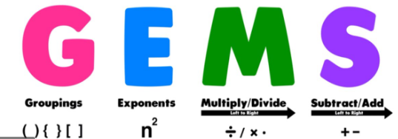
Arithmetic & Logical
Basic Arithmetic – Order of Operations
^
*
÷
+
-

Slide 6






Arithmetic & Logical
Arithmetic Calculation

Slide 7

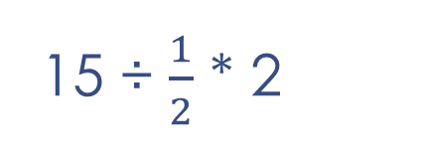
Arithmetic & Logical
Arithmetic Calculation
15 ÷ $\frac{1}{2}$ * 2
15 * $\frac{2}{1}$ * 2
60

Slide 8
Arithmetic & Logical
Arithmetic Calculation
4(-2)² + 8(-2) + 3(-2) + 6
4(4) + 8(-2) + 3(-2) + 6
16 -16 – 6 + 6
0

Slide 9
Arithmetic & Logical
Arithmetic Calculation
(8 + 4) * 3 - 10 / 2

Slide 10
Arithmetic & Logical
Arithmetic Calculation
The next number in the series
2, 5, 11, 20, 32, 47,

Slide 11
Arithmetic & Logical
Arithmetic Calculation
The next number in the series
1, 1, 2, 6, 24, 120, ___

Slide 12
Arithmetic & Logical
Arithmetic Calculation
In 2025, AllyBaba won the election with 50% of the votes. In 2020, he secured a landslide victory with 90%. Interesting shift!
Do people love him more now, or less?

Slide 13
Arithmetic & Logical
Arithmetic Calculation
AllyBaba bought shirts for $100 each from Tally Town. To sell them, he marked up the price by 10%. During the holiday season, he offered a 10% discount.
Did he make a profit, break even, or lose money?

Slide 14
Arithmetic & Logical
Arithmetic Calculation
Mary buys 8 widgets for $40.00. She adds $1.00 in enhancements to each widget and sells them for $9.00 each.
What is Mary’s estimated gross profit margin?

Slide 15
Arithmetic & Logical
Arithmetic Calculation
AllyBaba earned $5,000 from his business. He gave one-fifth of it to his daughter as a gift and then invested one-fourth of the remaining amount.
How much money is left in his account?

Slide 16
Arithmetic & Logical
Arithmetic Calculation
Which is larger
(-2)² or -2²

Slide 17
Arithmetic & Logical
Arithmetic Calculation
0/2 2/0

Slide 18
Arithmetic & Logical
Arithmetic Calculation
2% of 120

Slide 19
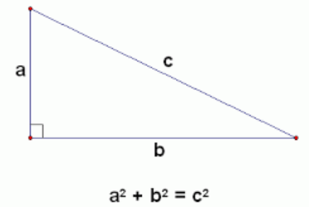
Arithmetic & Logical
Arithmetic Calculation
Pythagorean Theorem
To use the formula:
Must be a triangle
Must be a right triangle
C is the longest side - hypotenuse

Slide 20
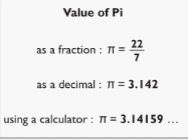
Arithmetic & Logical
Arithmetic Calculation
Value of Pi

Slide 21
Arithmetic & Logical Introduction
Logical Calculation
Boolean | Yes or No | True or False
Comparison
1. Equal to (==) - Checks if two values are equal.
2. Not equal to (!=) - Checks if two values are not equal.
3. Greater than (>) - Checks if the left value is greater than the right value.
4. Less than (<) - Checks if the left value is less than the right value.
5. Greater than or equal to (>=) - Checks if the left value is greater than or equal to the right value.
6. Less than or equal to (<=) - Checks if the left value is less than or equal to the right value.

Slide 22
Arithmetic & Logical Introduction
Logical Calculation
Relational
1. 1. AND (&&)
Definition: True if both conditions are true.
Example:
  Condition 1: Is it raining? — True
  Condition 2: Do I have an umbrella? — True
  Expression: Is it raining AND Do I have an umbrella? → True
2. OR (||)
Definition: True if at least one condition is true.
Example:
  Condition 1: Is it raining? — False
  Condition 2: Is it cloudy? — True
  Expression: Is it raining OR Is it cloudy? → True
3. NOT (!)
Definition: Inverts the truth value (True becomes False, False becomes True).
Example:
  Condition: Is it sunny? — False
  Expression: NOT Is it sunny? → True

Slide 23
Hardware & Software

Slide 24
Hardware
The hardware of computers refers to the physical components that make up a computer system. These are the tangible parts you can touch, unlike software which consists of programs and operating systems.
Here’s an overview of the main types of computer hardware:
🧠 1. Central Processing Unit (CPU) The “brain” of the computer. Executes instructions and manages tasks. 🧮 2. Memory (RAM – Random Access Memory) Temporarily stores data for active processes. More RAM = better multitasking. 💾 3. Storage Devices HDD (Hard Disk Drive): Uses spinning disks; higher capacity, slower. SSD (Solid State Drive): Faster, no moving parts, more expensive. External Drives/USBs: Portable storage solutions. 🖥️ 4. Input Devices Allow users to interact with the computer. Examples: Keyboard, Mouse, Scanner, Microphone, Webcam. 📺 5. Output Devices Display or produce results from the computer. Examples: Monitor, Printer, Speakers, Projector. | 🔌 6. Motherboard Main circuit board. Connects CPU, RAM, storage, and all peripherals. ⚡ 7. Power Supply Unit (PSU) Converts electricity from the outlet into usable power for the system. 🌬️ 8. Cooling Systems Prevent overheating. Include fans, heat sinks, and sometimes liquid cooling. 🌐 9. Network Components Network Interface Card (NIC), modems, Wi-Fi adapters. Connect the computer to the internet or other devices. 🖱️ 10. Peripheral Devices External hardware connected to the system. Examples: Game controllers, external hard drives, docking stations.

Slide 25
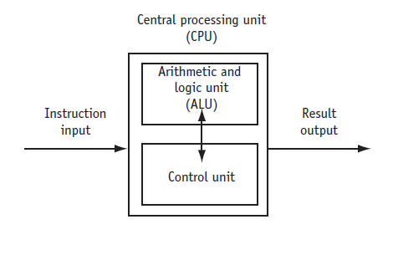
CPU
The Central Processing Unit (CPU) is often referred to as the "brain" of the computer. It performs most of the processing inside a computer and executes instructions from programs. Here’s a brief breakdown of its core components and functions:
🔧 Main Components of the CPU:
Arithmetic Logic Unit (ALU)
  Performs mathematical, logical, and decision operations.
Control Unit (CU)
  Directs the operation of the processor.
  Tells the memory, ALU, and input/output devices how to respond to instructions.
Registers
  Small, fast memory locations within the CPU used to store data temporarily during execution.
⚙️ Key Functions:
Fetch: Retrieves instructions from memory.
Decode: Translates the instruction into a form the CPU can understand.
Execute: Carries out the instruction (e.g., performing calculations or moving data).
📊 Important CPU Specs:
Clock speed (GHz): How many cycles per second the CPU can perform (higher = faster).
Cores: Each core is like a mini CPU; more cores allow more simultaneous tasks.
Threads: Threads are virtual versions of CPU cores that can improve multitasking.
Cache: Small memory inside the CPU to store frequently used data quickly.
🖥️ CPU in Practice:
In programming (like C++), the CPU executes compiled instructions line by line.
For performance-heavy applications (e.g., games, simulations), the CPU’s speed and number of cores matter a lot.

Slide 26
RAM
RAM stands for Random Access Memory. It's a type of computer hardware that:
Temporarily stores data that the CPU needs while your computer is on.
Is volatile memory, meaning its contents are lost when the computer is turned off.
Improves performance by allowing quick access to data and programs in use.
Key Points:
Acts as the short-term memory of the computer.
More RAM generally means your system can handle more tasks at once.
Comes in modules like DDR4 or DDR5 and is installed on the motherboard.

Slide 27
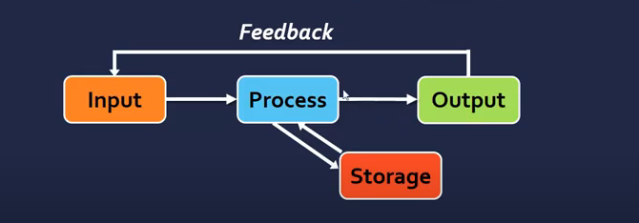
Computer Devices

Slide 28
Software
Software
Application software
Programs that make computer useful for every day tasks
Examples: word processing, email, games, Web browsers, web services
Controls everythcomputering the does
System Software
Operating system
Utility Program

Slide 29
Number Systems

Slide 30
Decimal, Binary and Hexadecimal
Our decimal system, also known as Base 10, uses place value to determine the value of a number.
Each digit in a number corresponds to a place that is a power of 10.
Recall the ones column, the tens column, the hundreds column, and so on.
The values are arranged from the Least Significant Digit (LSD) to the Most Significant Digit (MSD), starting from the right and moving left.
Examine the following table:
When we place numbers below each of the columns, we come up with a value.
For example, 69,648 when using the place value method comes out to this;
Then we just add them together and we come up with 69,648
10⁵ | 10⁴ | 10³ | 10² | 10¹ | 10⁰
100,000 | 10,000 | 1,000 | 100 | 10 | 1
.
10⁵ | 10⁴ | 10³ | 10² | 10¹ | 10⁰
0 | 6 | 9 | 6 | 4 | 8
0 | 60,000 | 9,000 | 600 | 40 | 8

Slide 31
Decimal, Binary and Hexadecimal
Binary is a Base2 system meaning there are only two numbers, 0 and 1.
Each number has a place value of 2^{n} where n is the place value position of the binary digit.
The method we use in Base10 to calculate a value is the same in Binary.
The only difference is we have a ones column, a twos column, a fours column, and so on.
In binary, the Least Significant Bit (LSB) is also on the right. And the Most Significant Bit (MSB) is on the left.
1100 is the binary equivalent to the Base10 value of 12. We can verify this by doing some math. We start by multiplying the binary value by the place value.
Everywhere there is a one, we multiply the decimal value of the column and ADD.
8 + 4 + 0 + 0 = 12.
Place Value | 2⁸ | 2⁷ | 2⁶ | 2⁵ | 2⁴ | 2³ | 2² | 2¹ | 2⁰
Binary Digit | 0 | 0 | 0 | 0 | 0 | 1 | 1 | 0 | 0
Place Value | 2³ | 2² | 2¹ | 2⁰
Decimal Value | 8 | 4 | 2 | 1
Binary Value | 1 | 1 | 0 | 0
Total | 8 | 4 | 0 | 0
.

Slide 32
Decimal, Binary and Hexadecimal
We can verify this by dividing the decimal value by 2 and recording the remainder (r).
Arrange the remainders into order from MSB to LSB and we end up with 1100
 | Remainder
12 / 2 = 6 | 0 | LSB
6 / 2 | 0
3 / 2 | 1
1 / 2 | 1 | MSB
.

Slide 33
Decimal, Binary and Hexadecimal
Hexadecimal, or simply Hex, is a Base16 system.
Instead of counting from 0 to 9 as with Base10, the number range is from 0 to F with A, B, C, D, and F representing 10, 11, 12, 13, 14, and 15 respectively.
When counting in decimal, we essentially start with 0 and count up to 9. Once we move past 9, we set the next column (or place value) to 1 and reset the first column back to 0 to get 10. Again, we count up and then the first column gets to 9, we add or increment the second column to 2 and reset the first back to 0 and so on.
With Hex, we essentially do the same thing, however, when we get to 9, we change to the letter A and continue until we reach the letter F. After that, we set the next column to 1 and reset the first column back to 0. So we get 0x10. This is a little confusing because the hex 0x10 is not the decimal 10. 0x10 is actually 16 decimal.
.

Slide 34
Decimal, Binary and Hexadecimal
The table shows the values from 0 to 16.
Note the 0x at the beginning of each hexadecimal value.
This prefix identifies the value as being in hexadecimal.
While we could use the subscript H (e.g., 1A3H) to denote hexadecimal, this is not commonly used.
Another method is to place the base value as a subscript, such as E₁₆, but this is typically only used when working with multiple base values.
Decimal | Hexadecimal
0 | 0x0
1 | 0x1
2 | 0x2
3 | 0x3
4 | 0x4
5 | 0x5
6 | 0x6
7 | 0x7
8 | 0x8
9 | 0x9
10 | 0xA
11 | 0xB
12 | 0xC
13 | 0xD
14 | 0xE
15 | 0xF
16 | 0x10
.

Slide 35
Decimal, Binary and Hexadecimal
Convert 0x305 to Decimal
Since the 0x is not calculated into our conversion, we will drop that to leave us with 305
Let’s check the accuracy
16² | 16¹ | 16⁰
256 | 16 | 1
3 | 0 | 5
768 | 0 | 5 | 768 + 0 + 5 = 773 (in decimal)
 | Remainder
773 / 16 = 48 | 5 | LSB
48 / 16 = 3 | 0
3 / 16 = 0 | 3 | MSB
.
Hex value is 305 or 0x305

Slide 36
Decimal, Binary and Hexadecimal
Convert 0xF65 to Decimal
Since the 0x is not calculated into our conversion, we will drop that to leave us with F65
Convert 0xEF8 to Decimal
Since the 0x is not calculated into our conversion, we will drop that to leave us with EF8
 | 16² | 16¹ | 16⁰
 | 256 | 16 | 1
Hex Number | F (15) | 6 | 5
 | 3840 | 96 | 5 | 3840 + 96 + 5 = 3941 (in decimal)
.
 | 16² | 16¹ | 16⁰
 | 256 | 16 | 1
Hex Number | E (14) | F (15) | 5
 | 3584 | 240 | 8 | 3584 + 240 + 8 = 3832 (in decimal)

Slide 37
Decimal, Binary and Hexadecimal
Convert the binary number 110110111011 to hexadecimal
Group the binary number into sets of 4 digits (from right to left):
  1101 1011 1011
(No padding needed in this case.)
Convert each group to hexadecimal
  1101 → D
  1011 → B
  1011 → B
Combine the hexadecimal digits:
  The hexadecimal representation is 0xDBB.
.

Slide 38
Decimal, Binary and Hexadecimal
Let's convert the binary number 1011101 to hexadecimal:
Group the binary number into sets of 4 digits (pad the leftmost group with zeros):
  0010 1110 1 → 0010 1110 0001
Convert each group to hexadecimal:
  0010 → 2
  1110 → E
  0001 → 1
Combine the hexadecimal digits:
  The hexadecimal representation is 0x2E1.
.

Slide 39
Decimal, Binary and Hexadecimal
Convert 3F to binary
  Hexadecimal value: 3F
  Convert each hex digit to binary:
    3 → 0011
    F → 1111
  Combine the binary values: 0011 1111
  The binary equivalent of 3F is 00111111.
Convert A9 to binary
  Hexadecimal value: A9
  Convert each hex digit to binary:
    A → 1010
    9 → 1001
  Combine the binary values: 1010 1001
  The binary equivalent of A9 is 10101001.
Convert 7C1 to binary
  Hexadecimal value: 7C1
  Convert each hex digit to binary:
    7 → 0111
    C → 1100
    1 → 0001
  Combine the binary values: 0111 1100 0001
  The binary equivalent of 7C1 is 011111000001.
.

Slide 40
Number Systems
Binary to Decimal (100111)
128 | 64 | 32 | 16 | 8 | 4 | 2 | 1
 |  | 1 | 0 | 0 | 1 | 1 | 1
 |  | 32 | 0 | 0 | 4 | 2 | 1
32 +0 + 0 + 4 + 2 + 1 = 39

Slide 41
Number Systems
Binary to Decimal (100111)
128 | 64 | 32 | 16 | 8 | 4 | 2 | 1
 |  | 1 | 0 | 0 | 1 | 1 | 1
 |  | 32 | 0 | 0 | 4 | 2 | 1
32 +0 + 0 + 4 + 2 + 1 = 39

Slide 42
Number Systems
Binary to Decimal (0100001) Practice
128 | 64 | 32 | 16 | 8 | 4 | 2 | 1

Slide 43
Number Systems
Binary to Decimal (1110001) Practice
128 | 64 | 32 | 16 | 8 | 4 | 2 | 1

Slide 44
Number Systems
Hexadecimal Number System
Base?
0 | 1 | 2 | 3 | 4 | 5 | 6 | 7 | 8 | 9 | A | B | C | D | E | F
Base 16 – Multiples of 16 for each Digit

Slide 45

Number Systems

Slide 46
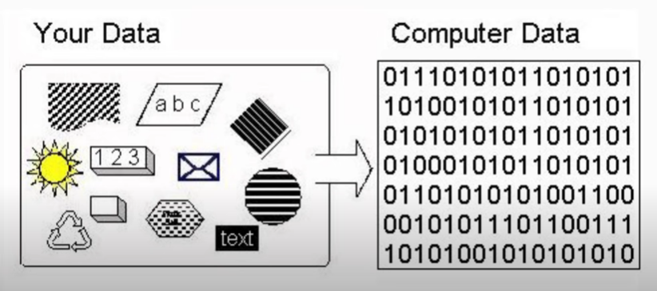
Data

Slide 47


Number Systems

Slide 48
Number Systems
American Standard Code for Information Interchange

Slide 49
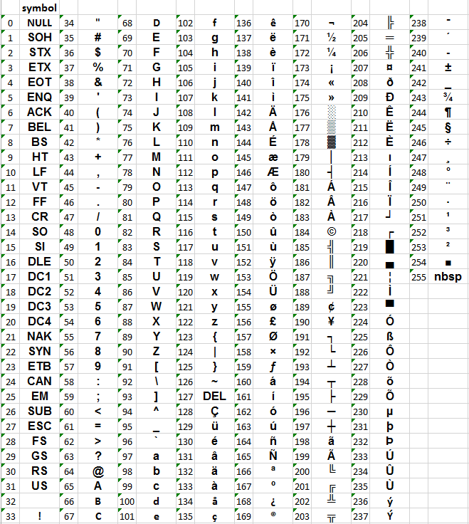
Number Systems
ASCII
Chart

Slide 50
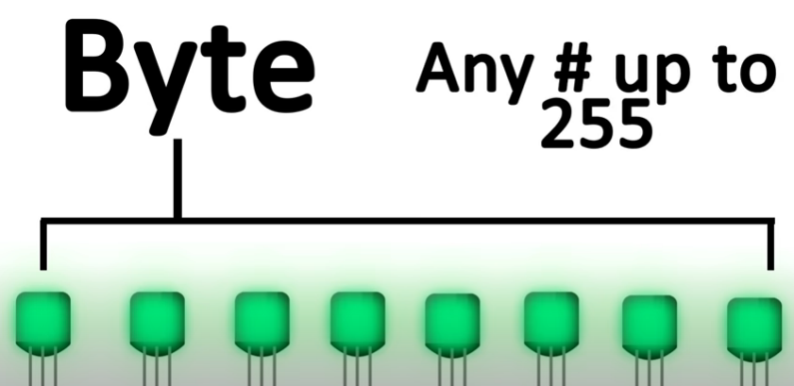
Number Systems

Slide 51
Data
Raw Facts
A computer stores data as sequences of 0s and 1s.
These are managed using electrical components that can hold a positive or negative charge, functioning like an on/off switch.
These basic units of data are known as bits.

Slide 52
Data

Slide 53
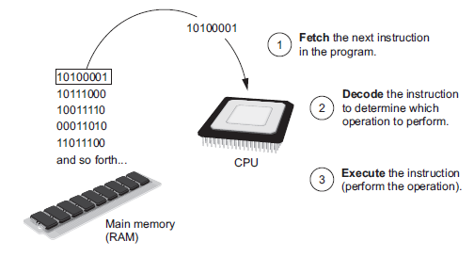
How Program Works
Program is copied from secondary memory to RAM each time CPU executes it.
CPU executes program in cycles
Fetch
    read the next instruction from memory into CPU
Decode
    CPU decodes fetched instruction to determine which operation to perform
Execute
    perform the operation

Slide 54
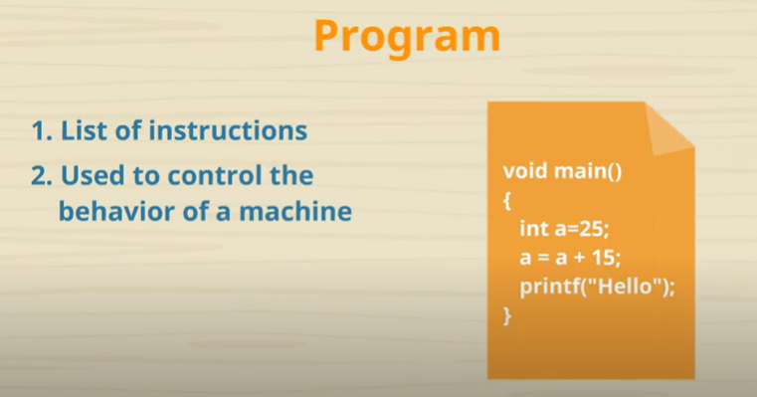
Programming Languages
  Computer’s are only smart because we program them to be.

Slide 55
Programming Languages
Programming
  Attempting to get a computer to complete a specific task without making any mistakes
  In order to talk to computer, we must first translate your English instructions to Binary
  It would be entirely unpractical to convert every programming instruction we have into binary by hand
  Programming languages serve as a middle-man
  Translate your instructions in to machine code with series of 0’s and 1’s that the computer can understand

Slide 56

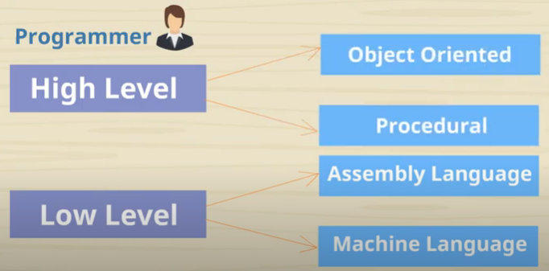
Programming Languages

Slide 57

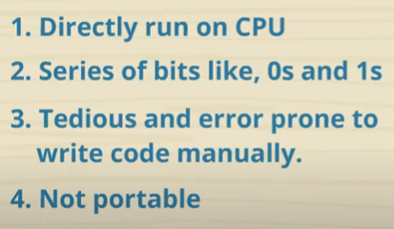
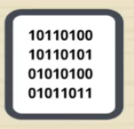
Programming Languages

Slide 58

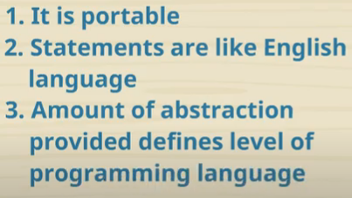
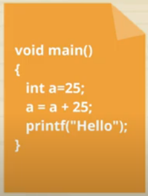

Programming Languages

Slide 59
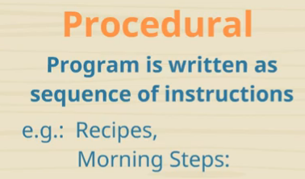
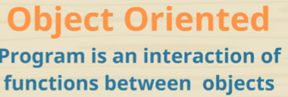
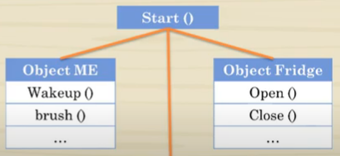
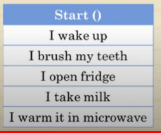
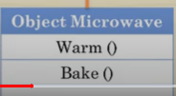
Programming Languages

Slide 60
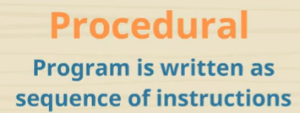
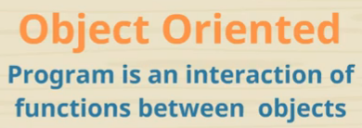
Programming Languages
Top down approach
It doesn’t have proper way for hiding data
Data is not secured
Code is interdependent
Reuse if difficult
Bottom up approach
Helps in wrapping data and functions in a class
Helps Building secure programs
Code is modular
Can be reused

Slide 61


How High Level Languages Converted
Translates high level instruction into machine language
Generates an executable file like .exe
Used by C++
Translates high level instruction into an intermediate code
Each and every line executed individually
Used by Python language

Slide 62
How High Level Languages Converted
Translates high level instruction into machine language
Generates an executable file like .exe
Used by C++
Translates high level instruction into an intermediate code
Each and every line executed individually
Used by Python language

Slide 63
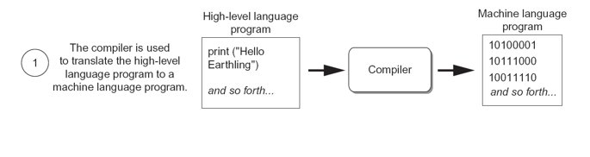
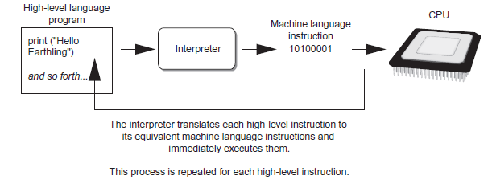
Compilers and Interpreters

